Slide 1

MEDICAL AI · DIGITAL HEALTH · ALGERIA
Animiea
End-to-End AI Solution for Non-Invasive Anemia Detection
Dr. Abderrahmane Khiat · Animiea Startup · 2025

Slide 2



THE PROBLEM
1.6B+
Costly
0
People affected
by anemia worldwide
Invasive blood tests:
expensive & unscalable
Continuous monitoring
solutions for mothers
🇩🇿 In Algeria, thousands of severe maternal anemia cases require annual clinical intervention (WHO / Statista, 2021)

Slide 3
OUR INNOVATION
AI-powered • Non-invasive • Personalized
01
02
03
04
Capture
Segment
Classify
Recommend
Smartphone camera photographs the palpebral conjunctiva (inner lower eyelid).
U-Net AI model isolates the Region of Interest (ROI) with precision.
MobileNet / ResNet / DenseNet evaluates pallor severity & hemoglobin levels.
Personalized medical advice & continuous tracking delivered instantly.

Slide 4


CLINICAL & TECHNICAL BASIS
Clinical Hypothesis
Deep Learning Stack
Conjunctival pallor — the paleness of the inner lower eyelid — is a well-established optical biomarker correlated with hemoglobin deficiency.
By imaging this region with a standard smartphone camera, our AI can non-invasively estimate anemia severity without drawing blood.
U-Net
Precise conjunctiva segmentation (ROI)
ResNet
Deep residual classification of pallor
DenseNet
Densely connected pallor severity scoring
MobileNet
Lightweight inference on low-end phones
Trained on diverse cohorts from India & Italy — demographic-bias-free

Slide 5
U-NET SEGMENTATION ARCHITECTURE
Palpebral Conjunctiva Isolation — Region of Interest (ROI)
ENCODER
BOTTLENECK
DECODER
Downsampling Path
Peak Feature Space
Upsampling Path
3 ch → 64 ch
64 ch → 128 ch
128 ch → 256 ch
256 ch → 512 ch
512 ch → 1024 ch
1024 ch → 512 ch
512 ch → 256 ch
256 ch → 128 ch
128 ch → 64 ch
DoubleConv Block
Maximum abstraction
before reconstruction
→
→
DoubleConv → BN → ReLU
ConvTranspose2d + Skip
Skip Connections ↕
Adam | LR: 1e-4 | Batch: 8/4
Output: Conv2d(64,1,1) → Mask
Best Validation Loss: 0.5709 | Optimizer: Adam | ReduceLROnPlateau (patience=5, factor=0.5) | Batch: 8 / 4

Slide 6
CNN CLASSIFICATION ARCHITECTURE
Pallor Severity Classification & Hemoglobin Estimation — 3 Model Variants
SHARED PIPELINE › Input: ROI Image → Feature Extraction Base → Global Pool → Dense Layers → Class Probability
MobileNet
ResNet
DenseNet
Depthwise Separable Convolutions
Deep Residual Networks
Dense Feed-Forward Connections
Designed for edge/mobile devices.
Ultra-lightweight architecture
optimized for real-time smartphone
inference on low-end hardware.
Optimizer: Adam
Loss: Categorical Cross-Entropy
Skip connections bypass layers
eliminating vanishing gradients.
Extracts deep, complex pallor
variations with high fidelity.
Optimizer: Adam
Loss: Categorical Cross-Entropy
Every layer connects to all
subsequent layers, maximizing
feature reuse and visual texture
retention across depth levels.
Optimizer: Adam
Loss: Categorical Cross-Entropy
Peak Val Accuracy
Peak Val Accuracy
Peak Val Accuracy
97.90%
98.80%
97.70%

Slide 7
MODEL RESULTS & PERFORMANCE
All CNN architectures achieve diagnostic parity with clinical standards
94.57%
96.12%
92.89%
0.1162
Global Accuracy
Global Precision
Global Recall
Loss Convergence
ARCHITECTURE BREAKDOWN · Peak Validation Metrics Per Model
Architecture
Val Accuracy
Val Loss
Precision
Recall
ResNet
98.80%
0.0377
—
—
DenseNet
97.70%
0.0635
—
—
MobileNet (Final)
97.90%
0.0566
97.43%
98.40%
U-Net (Seg.)
—
0.5709
—
—
U-Net Seg. Best Val Loss: 0.5709 · Effectively isolates conjunctiva morphology for downstream classification

Slide 8
CLASSIFICATION REPORT & CONFUSION MATRIX
MobileNet (Final Deployed Model) — Test Set Evaluation
CONFUSION MATRIX
CLASSIFICATION REPORT
Predicted
Class
Precision
Recall
F1-Score
Support
Not Anemic
Anemic
Not Anemic
95.60%
95.60%
95.60%
91
Not
Anemic
87
4
Anemic
95.40%
95.40%
95.40%
90
Actual
TN
FP
Accuracy
95.03%
181
Anemic
7
83
Macro Avg
95.50%
95.50%
95.50%
181
FN
TP
Weighted Avg
95.51%
95.03%
95.27%
181
Test set: 181 samples · Not Anemic: 91 · Anemic: 90
Overall Accuracy: 94.57% · Precision: 96.12% · Recall: 92.89% · Loss: 0.1162 · Trained: MobileNet v2 · Adam · Categorical CE

Slide 9
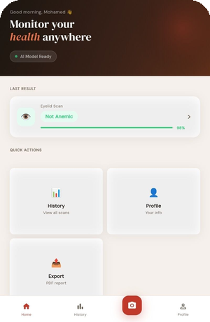
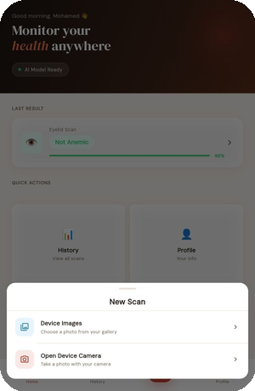
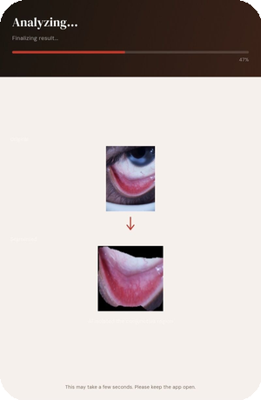
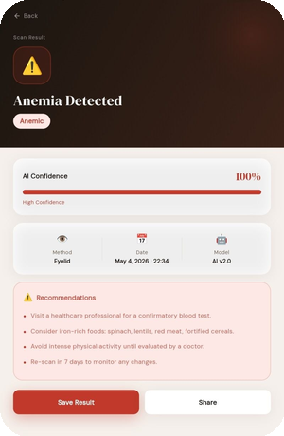
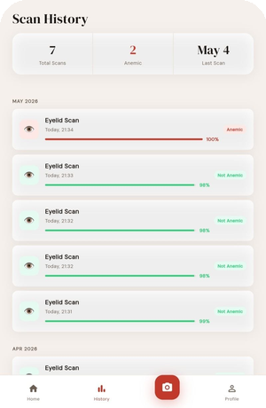
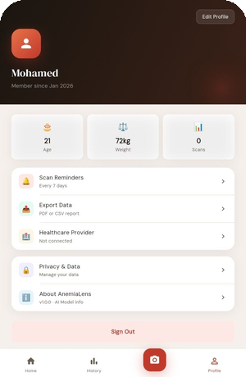
ANIMIEA APP — LIVE SCREENS
Flutter · AI v2.0 · Non-Invasive · Real-Time Results in < 30s
Home Dashboard
New Scan
AI Analyzing
Last result & quick actions
Camera or gallery input
U-Net segmentation live
Scan Result
Scan History
User Profile
Anemia detected · 100% confidence
All past scans & trends
Health data & reminders

Slide 10

WHY ANIMIEA IS BETTER
Traditional Method
Animiea AI System
Invasive – requires blood draw
Non-invasive optical scan
VS
High cost + slow lab processing
Low cost, instant results
VS
One-off episodic test
Continuous patient monitoring
VS
Unscalable in remote areas
Highly scalable software solution
VS

Slide 11
SCALABILITY PLAN
Phase 1
Hospital Pilot – Algeria
Pilot deployment in Algerian maternity & hematology departments. Clinical integration and real-world validation.
Phase 2
Cross-Device Testing
Flutter App tested on varying low-end smartphones. MobileNet ensures low-latency inference across all devices.
Phase 3
Regional Expansion
Expanding to underserved regions across MENA & Sub-Saharan Africa using our demographic-bias-free model.

Slide 12

THE TEAM
Dr. Abderrahmane Khiat
Founder & R&D Lead · PhD in Computer Science
Expert in AI systems & digital health. Former Project Lead at Fraunhofer IAIS · IT Project Manager at Hyundai AutoEver
Development Team
Guerroudji Djamel Eddin Ysser
Gousas Mohamed Houcin
AI Engineer
Backend / FastAPI
Abadi Aymen
Sahraoui Nabil
Mobile Dev / Flutter
Deep Learning

Slide 13

Join Us in Transforming
Anemia Diagnosis Worldwide
Dr. Abderrahmane Khiat · Founder & Project Lead
Animiea Startup · Algeria · 2025
Ready for pilot deployment in Algerian hospitals
animiea.startup@gmail.com · linkedin.com/in/animiea · +213 (Algeria)

Slide 14
AnemiaLens
1.6B
35%
Non-Invasive Anemia Detection
People with anemia globally
Children affected in Algeria
Powered by Artificial Intelligence
<30s
85%
Business Model & Investment Deck
Algeria · 2026
Time to result
Cost reduction vs CBC lab

Slide 15



THE PROBLEM
Anemia: Algeria's Silent Epidemic
25–30% of women affected
Lab infrastructure gap
4–24 hours wait time
Women of reproductive age and children under 5 bear the highest burden. Most cases are never detected due to access barriers.
Traditional CBC tests require labs, technicians, and needles. In the Sud and Hautes Plaines, labs are scarce or non-existent.
Results take hours to days. Patients in rural areas make a second trip — many never return for follow-up treatment.

Slide 16




OUR SOLUTION
Instant Anemia Screening — No Lab Required
Patient
Capture Image
AI Analysis
Result
Doctor Acts
No needle
Conjunctiva
< 30 seconds
Positive / Negative
Confirm or treat
Non-invasive — no blood draw
Results in under 30 seconds
Works on any smartphone or tablet
Deployable in zero-lab environments

Slide 17


VALUE PROPOSITION
Who benefits — and how
Hospitals & Clinics (B2B Core)
Patients (End-User Value)
State & Ministry of Health
Increase patient throughput — scan more in less time
Zero pain — no needles, no blood draw
Scalable mass screening for Sud & Hautes Plaines
Instant triage layer before expensive CBC lab work
Result in under 30 seconds, not hours or days
Aligns with Plan Santé Numérique 2023–2027
Reduce reagents, technician time & equipment wear
Cost 100–200 DZD vs 800–1 500 DZD for lab CBC
Reduces pressure on public lab capacity
Competitive edge: 'AI-powered' branding attracts patients
Accessible in rural areas with no lab infrastructure
Population anemia data for national health policy
CHU/EHS: comply with MoH digitalization mandates
No appointment or lab visit required
CNAS cost reduction on untreated anemia cases

Slide 18
MARKET ANALYSIS
Algeria's Anemia Market — A Massive Untapped Opportunity
~27%
35%
2 800+
1 200+
Women of reproductive
age with anemia
Children under 5
affected (UNICEF)
Public health
facilities in Algeria
Private clinics
(+12%/year)
Market Sizing
B2B Target Segments
TAM
60M screenings/year — All health facilities in Algeria needing CBC/anemia work
Private Clinics
Gynaecology & Paediatrics — highest anemia risk groups. Premium pricing justified.
SAM
18M screenings/year — Facilities with smartphone/digital access (~4 000 sites)
Public Hospitals CHU/EPH
Triage efficiency. Ministry of Health priority. High volume.
SOM
100M DZD Year 1 — 50 pilot sites × 500 000 scans @ 200 DZD/scan
Pharmacies
Transform into 'mini-diagnostic hubs'. Huge reach — 12 000+ pharmacies in Algeria.

Slide 19
COST COMPARISON
The Economic Disruptor
Feature
Traditional Lab CBC
AnemiaAI Solution
Cost to patient
800 – 1 500 DZD
100 – 200 DZD
Time to result
4 – 24 hours
< 30 seconds
Equipment needed
Hematology analyzer
($10 000+)
Smartphone / tablet
Consumables
Reagents, needles,
tubes
None (software only)
Trained technician
Required
Not required
Rural deployment
Not feasible
Fully feasible
AnemiaAI reduces screening cost by up to 85% and delivers results 480× faster than traditional lab methods

Slide 20

BUSINESS MODEL
Revenue Streams — B2B Recurring Model
A · SaaS Subscription
PRIMARY
B · Pay-per-Scan API
SCALABLE
Monthly/annual license per facility
• Starter: 80 000 DZD/mo (500 scans)
• Professional: 200 000 DZD/mo (2 000 scans)
• Enterprise: Custom / unlimited
Large diagnostic centres pay per use
• 50–150 DZD per scan via API
• Ideal for high-volume CHU
• Integrates into existing HIS/EHR
C · Data & Analytics
PASSIVE
D · Hardware Leasing
LOCK-IN
Anonymised population health data
• Sold to pharma (Saidal, iron supplement cos.)
• Insurance actuarial modelling (AXA, GAM)
• MoH national screening reports
Dedicated locked medical tablet
• Pre-installed app, branded device
• Monthly hardware + software bundle
• Prevents churn, ensures compliance
~70%
6 mo
24–36 mo
<5%
Gross margin (SaaS)
Payback period
Avg contract length
Annual churn target

Slide 21
ROI FOR HOSPITALS
How do hospitals make money from AnemiaAI?
01
Charge patients for AI screening
ROI Calculator
Bill 500–800 DZD/scan while paying us 150–250 DZD → direct profit per scan
Hospital doing 100 scans/day
02
Eliminate lab overhead
Monthly subscription
200 000 DZD
Save 1 200–2 500 DZD per test avoided in reagents, technician overtime & equipment
Scans/month (100×30)
3 000 scans
03
Increase patient throughput
Faster diagnosis = more consultations per day = more revenue per bed
Saved per scan (avg)
1 200 DZD
04
CNAS/insurance billing
Total lab saving/month
3 600 000 DZD
AI screenings are being integrated into CNAS reimbursement billing codes
Net benefit/month
3 400 000 DZD
05
Premium 'AI hospital' positioning
ROI
1 700%
Attract more patients, justify higher consultation fees vs non-AI competitors

Slide 22
COMPETITIVE LANDSCAPE
Where we stand in Algeria's health-tech market
Competitor
Type
Algeria presence
Gap we fill
Sysmex / Mindray
Hardware analyzer
Strong — high cost
No upfront investment needed
Private labs (Pasteur etc.)
Manual CBC lab
Nationwide
Mobile, instant, 10× cheaper
Doctocare / Tabiblib
Appointment apps
Growing
Diagnostics, not scheduling
Scanwell / Sight OAL
AI diagnostics
Not present
Local pricing + Arabic support
AnemiaAI (us)
AI screening SaaS
First mover
Full package: local + affordable
Data moat
Switching cost
Local compliance
Every scan improves our model. Local Algerian data competitors cannot access.
Once integrated into HIS/EHR, switching requires retraining and re-approval.
MSPRH / CNAS / ONSSA knowledge that foreign players take 3+ years to replicate.

Slide 23
GO-TO-MARKET STRATEGY
3-Phase B2B Rollout Across Algeria
01
Clinical Pilot
02
B2B Expansion
03
National Scale
Months 1–6
Months 7–18
Month 18+
Partner with 3–5 hospitals (Algiers, Oran, Constantine)
Convert pilots to paid Starter/Professional contracts
MoH framework tender — win 100+ hospitals at once
Offer free 3-month pilot with full data access
Target 50 facilities across 10 wilayas
Freemium tier: 10 free scans/month for rural EPHs
Co-author clinical validation study with CHU champion
Present at SIPHAL pharmacy convention
API licensing to EHR/HIS vendors
Target accuracy ≥ 92%, collect Algerian case studies
Apply for MSPRH approval & CNAS billing code
Regional expansion: Morocco, Tunisia, Mauritania
Sales channels:
Direct B2B sales team
MoH public tender
Medical distributors (15-20% commission)
SIPHAL / medical conferences

Slide 24


PARTNERSHIPS
Strategic alliances that accelerate growth
CHU / EHS Hospitals
MSPRH (Ministry of Health)
Saidal & Pharma (Iron supplements)
Clinical validation & co-authorship. Free perpetual license + data revenue share in exchange for study access.
Certification & public-hospital entry. Essential for national rollout via framework tender contracts.
They sponsor our app because we identify their target market. Data licensing & co-marketing deals.
Djezzy / Ooredoo / Mobilis
Medical Distributors
USTHB / Univ. Tlemcen (Academic)
'Health Data Plan' — app traffic is free/subsidized. Reach rural users with zero connectivity cost.
Companies like Sterimex & Aleph Medical carry us into hospital procurement at 15–20% commission.
Joint grants, annotated datasets, peer-reviewed accuracy publications, and talent pipeline.

Slide 25
ANTICIPATED Q&A
Key questions — and our answers
Q: How do you make money?
Q: Why would a hospital already owning a CBC machine pay for this?
B2B SaaS subscription (80k–500k+ DZD/mo per facility) + per-scan API pricing + data licensing to pharma + API to EHR vendors.
We are a pre-filter. 60–70% of CBC orders come back negative. We handle those non-invasively, saving reagents, staff time & machine wear.
Q: What if the AI is wrong? Who is liable?
Q: Is this approved by Algerian authorities?
We are a screening tool — doctors confirm all results. Our ToS classifies us as a 'decision support system'. Liability stays with the physician.
We follow the MSPRH medical device pathway (Decree 92-276). Classified as 'decision support' = lighter pathway. Target: approval in 6–12 months.
Q: What stops big companies from copying you?
Q: How does your AI actually work?
Data moat (local Algerian dataset), MSPRH regulatory knowledge (3+ years to replicate), and HIS switching cost once deployed.
Analyzes conjunctival pallor, nail bed colour, and palmar pallor via smartphone camera — WHO IMCI-validated proxies for anemia used in resource-limited settings.

Slide 26
One in three Algerian children has anemia.
Most will never be diagnosed — because the test costs too much
and the nearest lab is 100 km away.
AnemiaAI changes that.
A smartphone. 30 seconds. A life detected.
Clinical pilot partner
Investment discussion
MoH / MSPRH introduction
Interested in any of the above?

